Slide 1
REVRB And Personnel Changes

Slide 2
REVERB
5 Scenarios
Personnel
New Positions
Reclasses

Slide 4
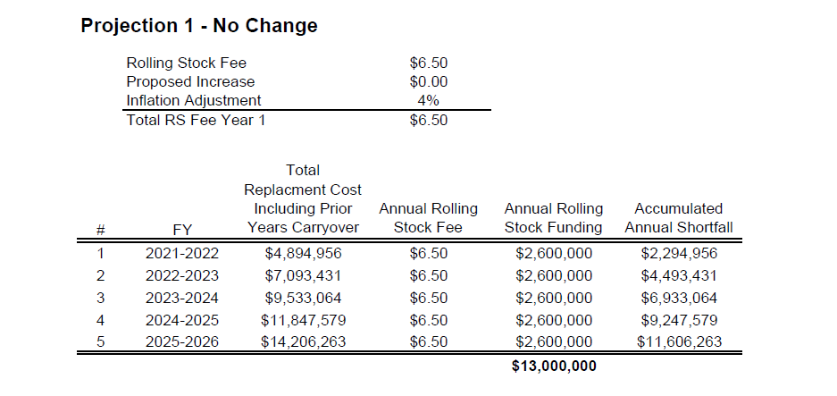
PROJECTION 1

Slide 5
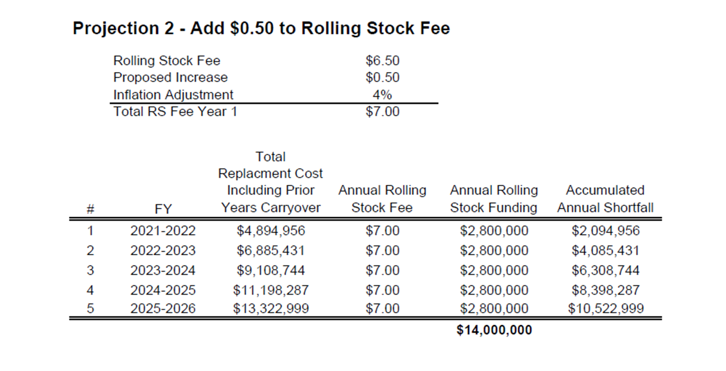
PROJECTION 2

Slide 6
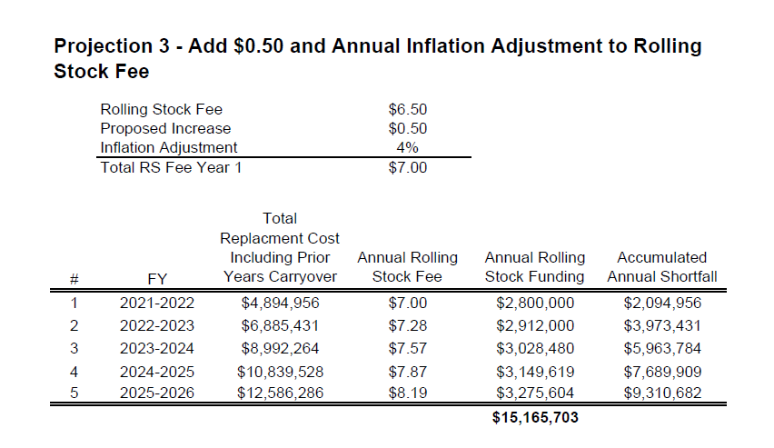
PROJECTION 3

Slide 7
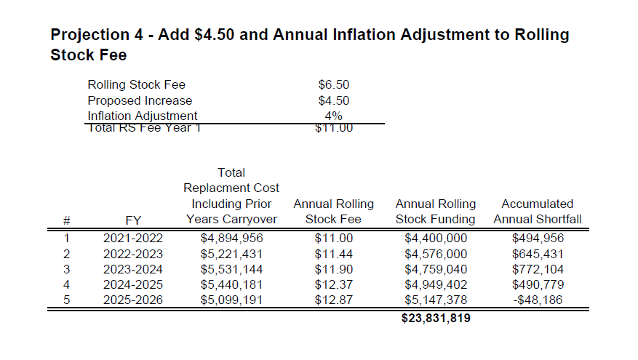
PROJECTION 4

Slide 8
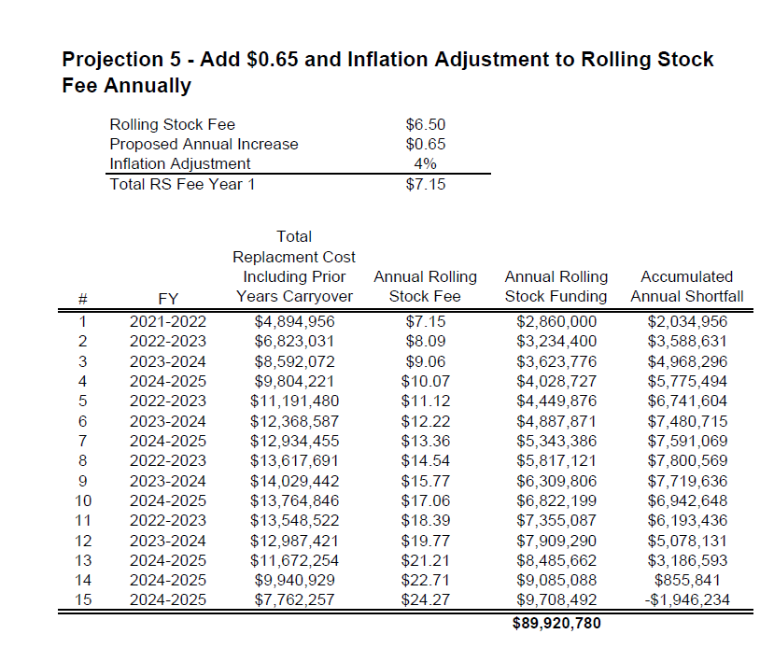
PROJECTION 5

Slide 9
PERSONNEL
New Positions
Reclasses

Slide 10
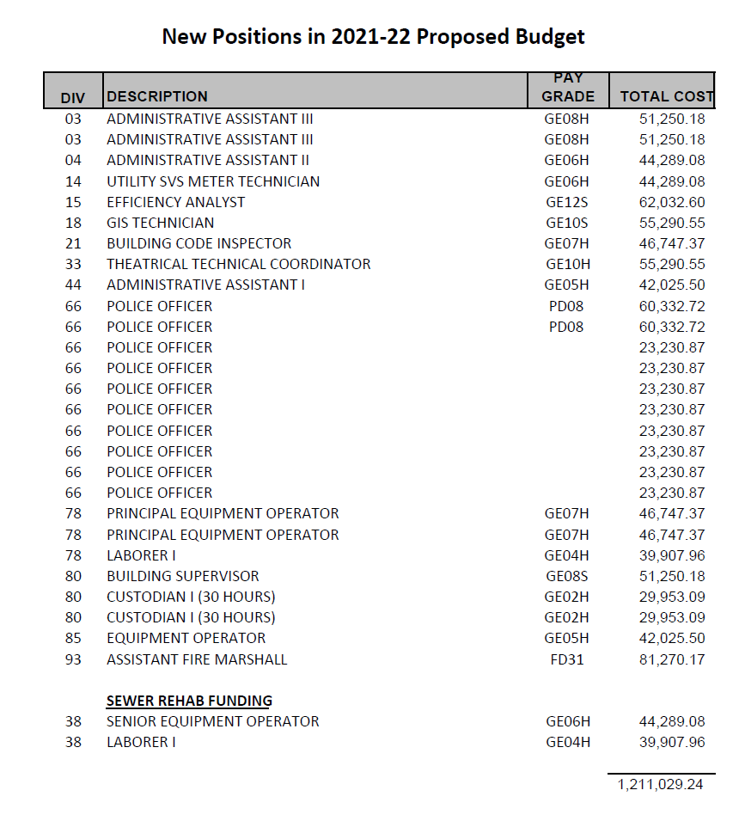
New Positions in
2021-22 Proposed Budget
Total Cost: 1,211,029

Slide 11
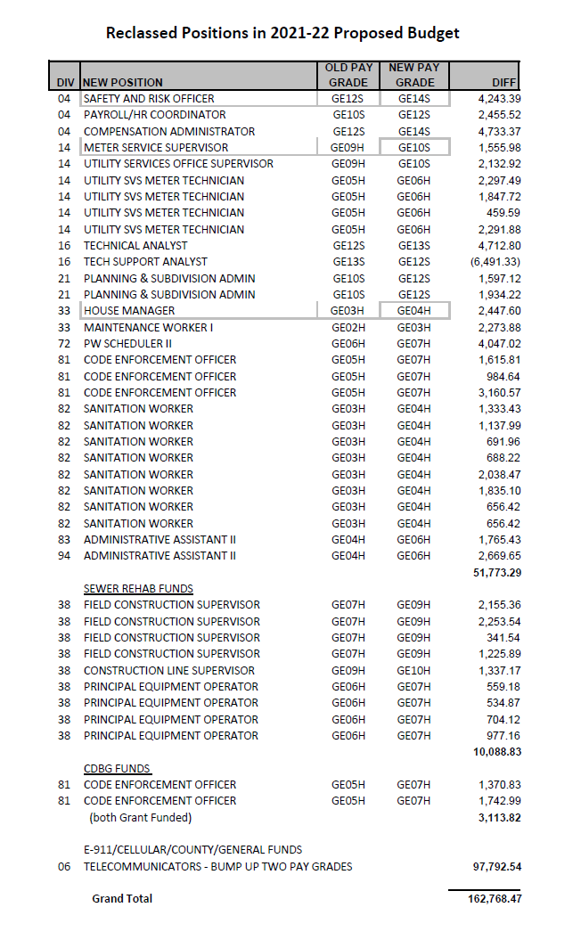
Reclassed Positions in 2021-22 Proposed Budget
Grand Total: 162,768

Slide 12
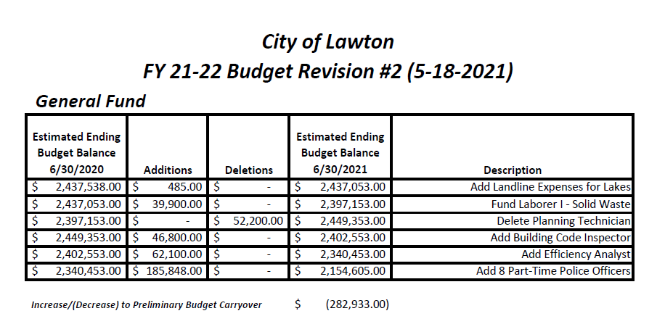

Slide 13
