Slide 2
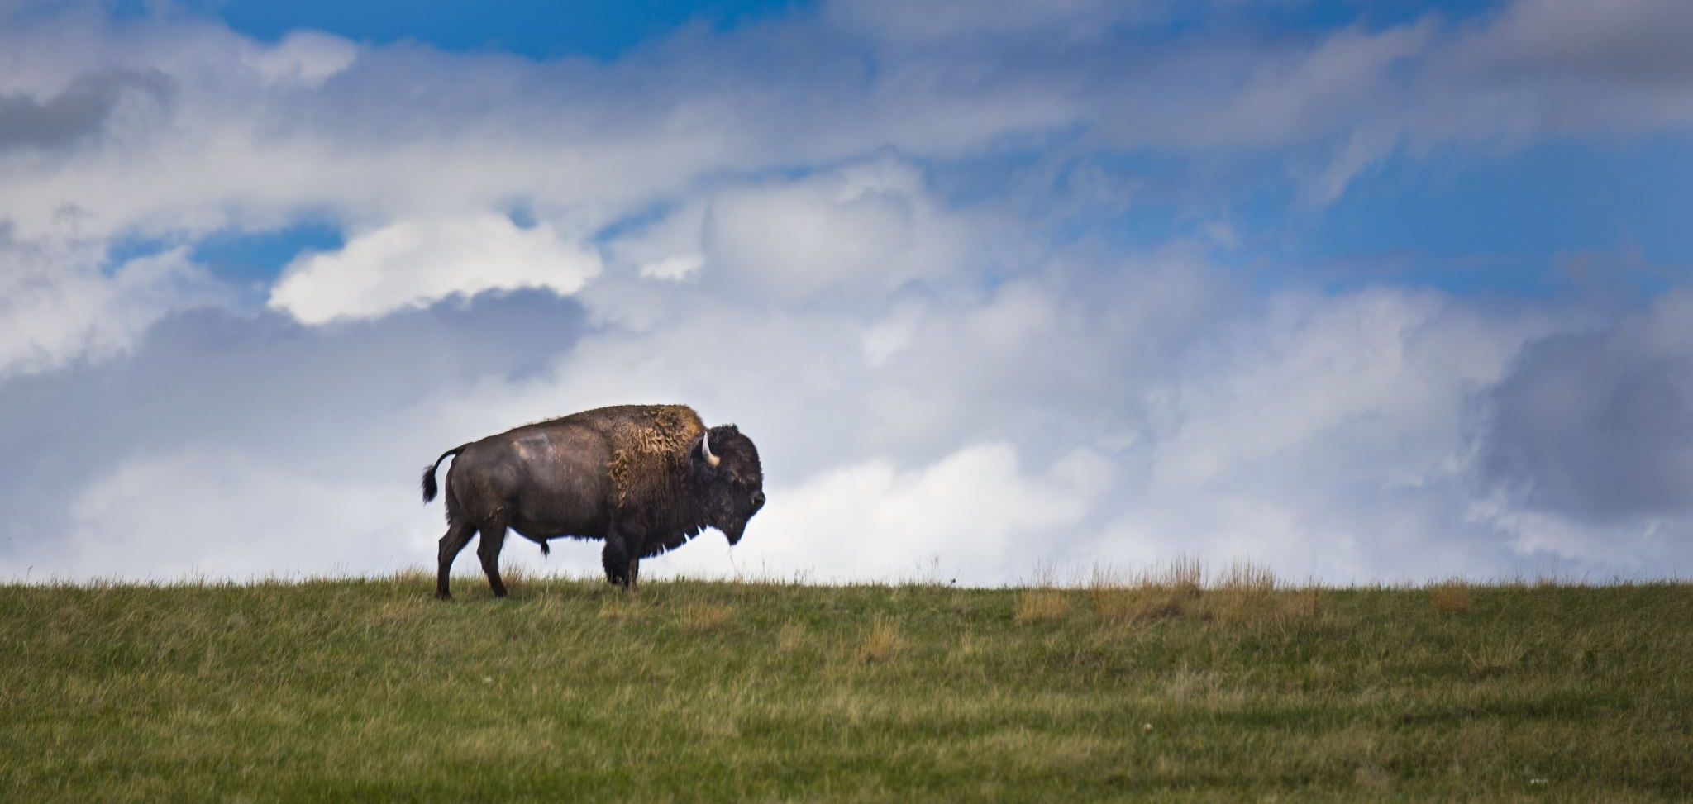
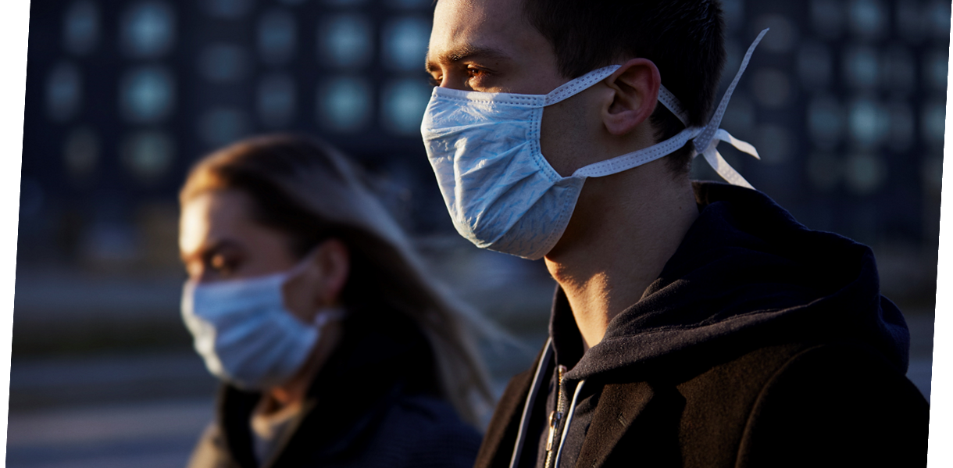
The 20-21 Year in Review
Pandemic
Revenues
Sales and Use Tax
5% YTD over prior year
Utility (Enterprise Fund)
5.5% over prior year
Reduction of Expenses
Personnel
Removed 45 positions from prior 2019-20 year
Postpone Reclassifications

Slide 3
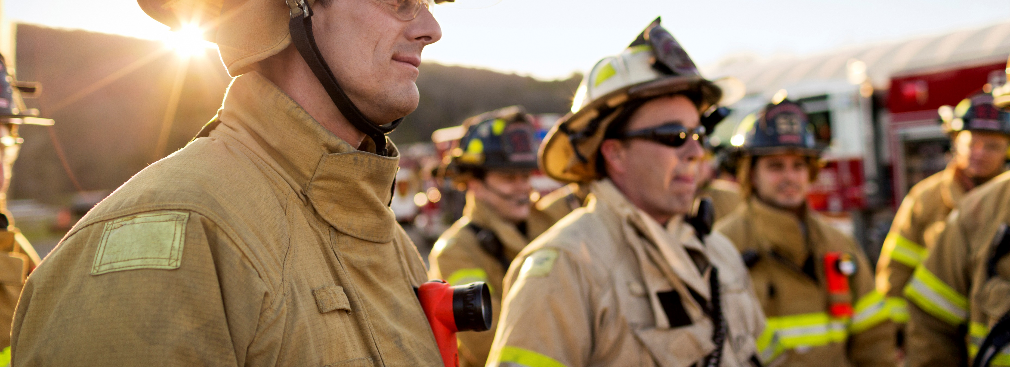
2021-22
Adapts economically while assuring best service to citizens
2019 Propel
FISTA
STEDI
TIF District No. 3
Republic Paper Mill
West Lawton Industrial and Airpark Centers (1,358 Acres)
Steps to Improve
Code Enforcement
Utility Service
Police Service
Fire Service
Emergency Communications
City Administration
Arts & Humanities
Recreation
Sewer and Wastewater
More

Slide 4
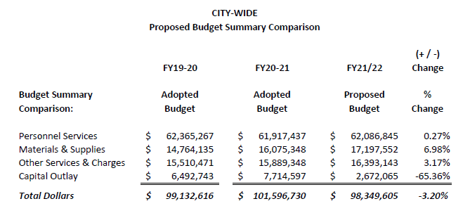
Proposed Budget Summary Comparison Graph

Slide 5
Personnel Changes
Reclass $13,203
Additions (20 Employees) $1,043,602
No COLA

Slide 6
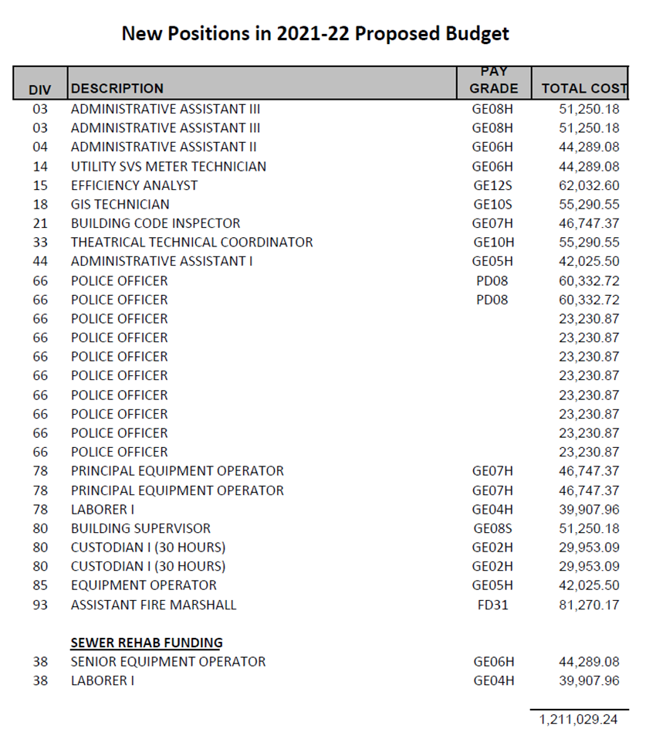
New Positions in
2021-22 Proposed Budget
Total Cost: 1,211,029

Slide 7
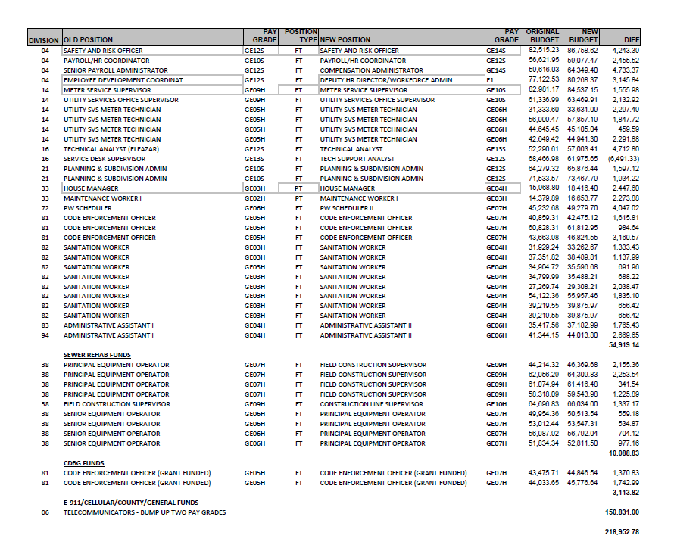
Reclassed Positions in 2021-22 Proposed Budget
Grand Total: 218,952.78

Slide 8
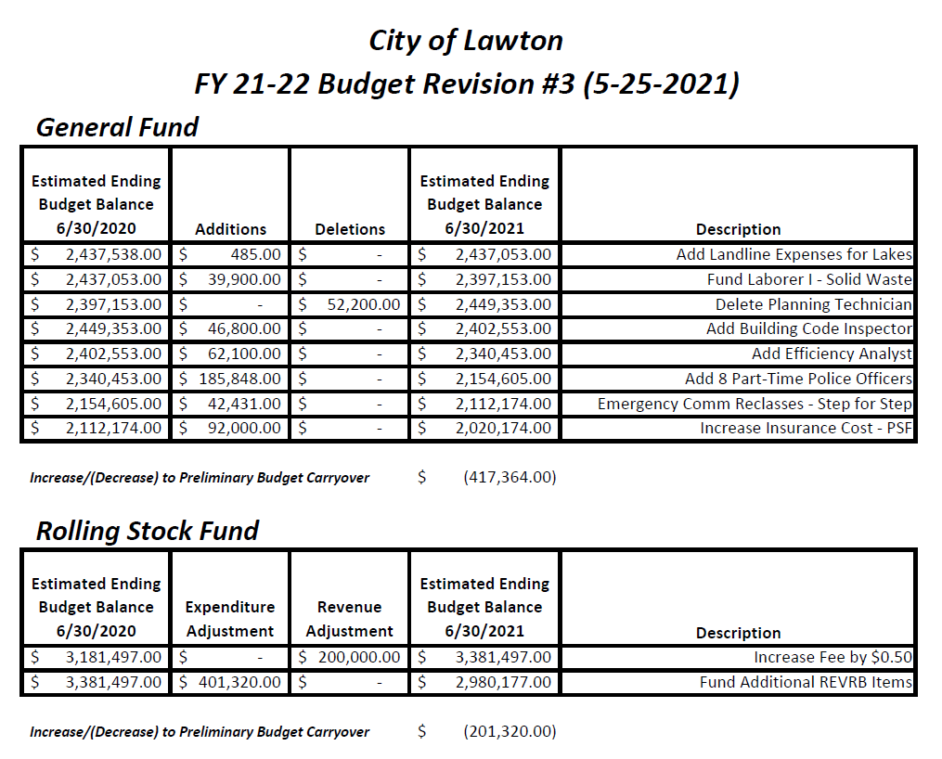

Slide 9
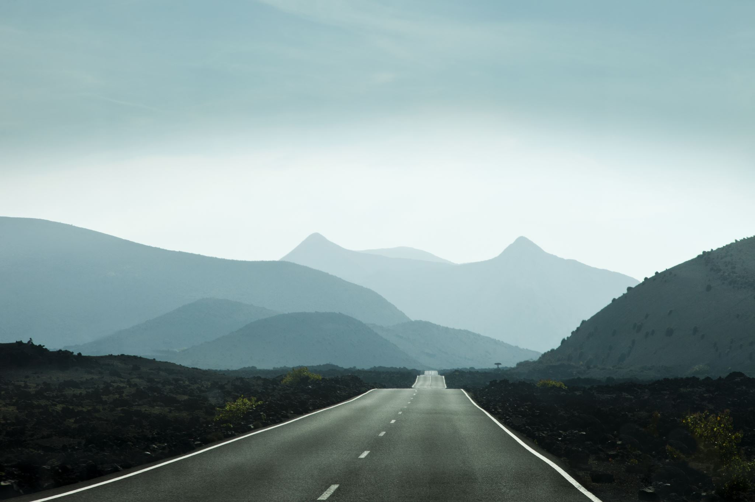
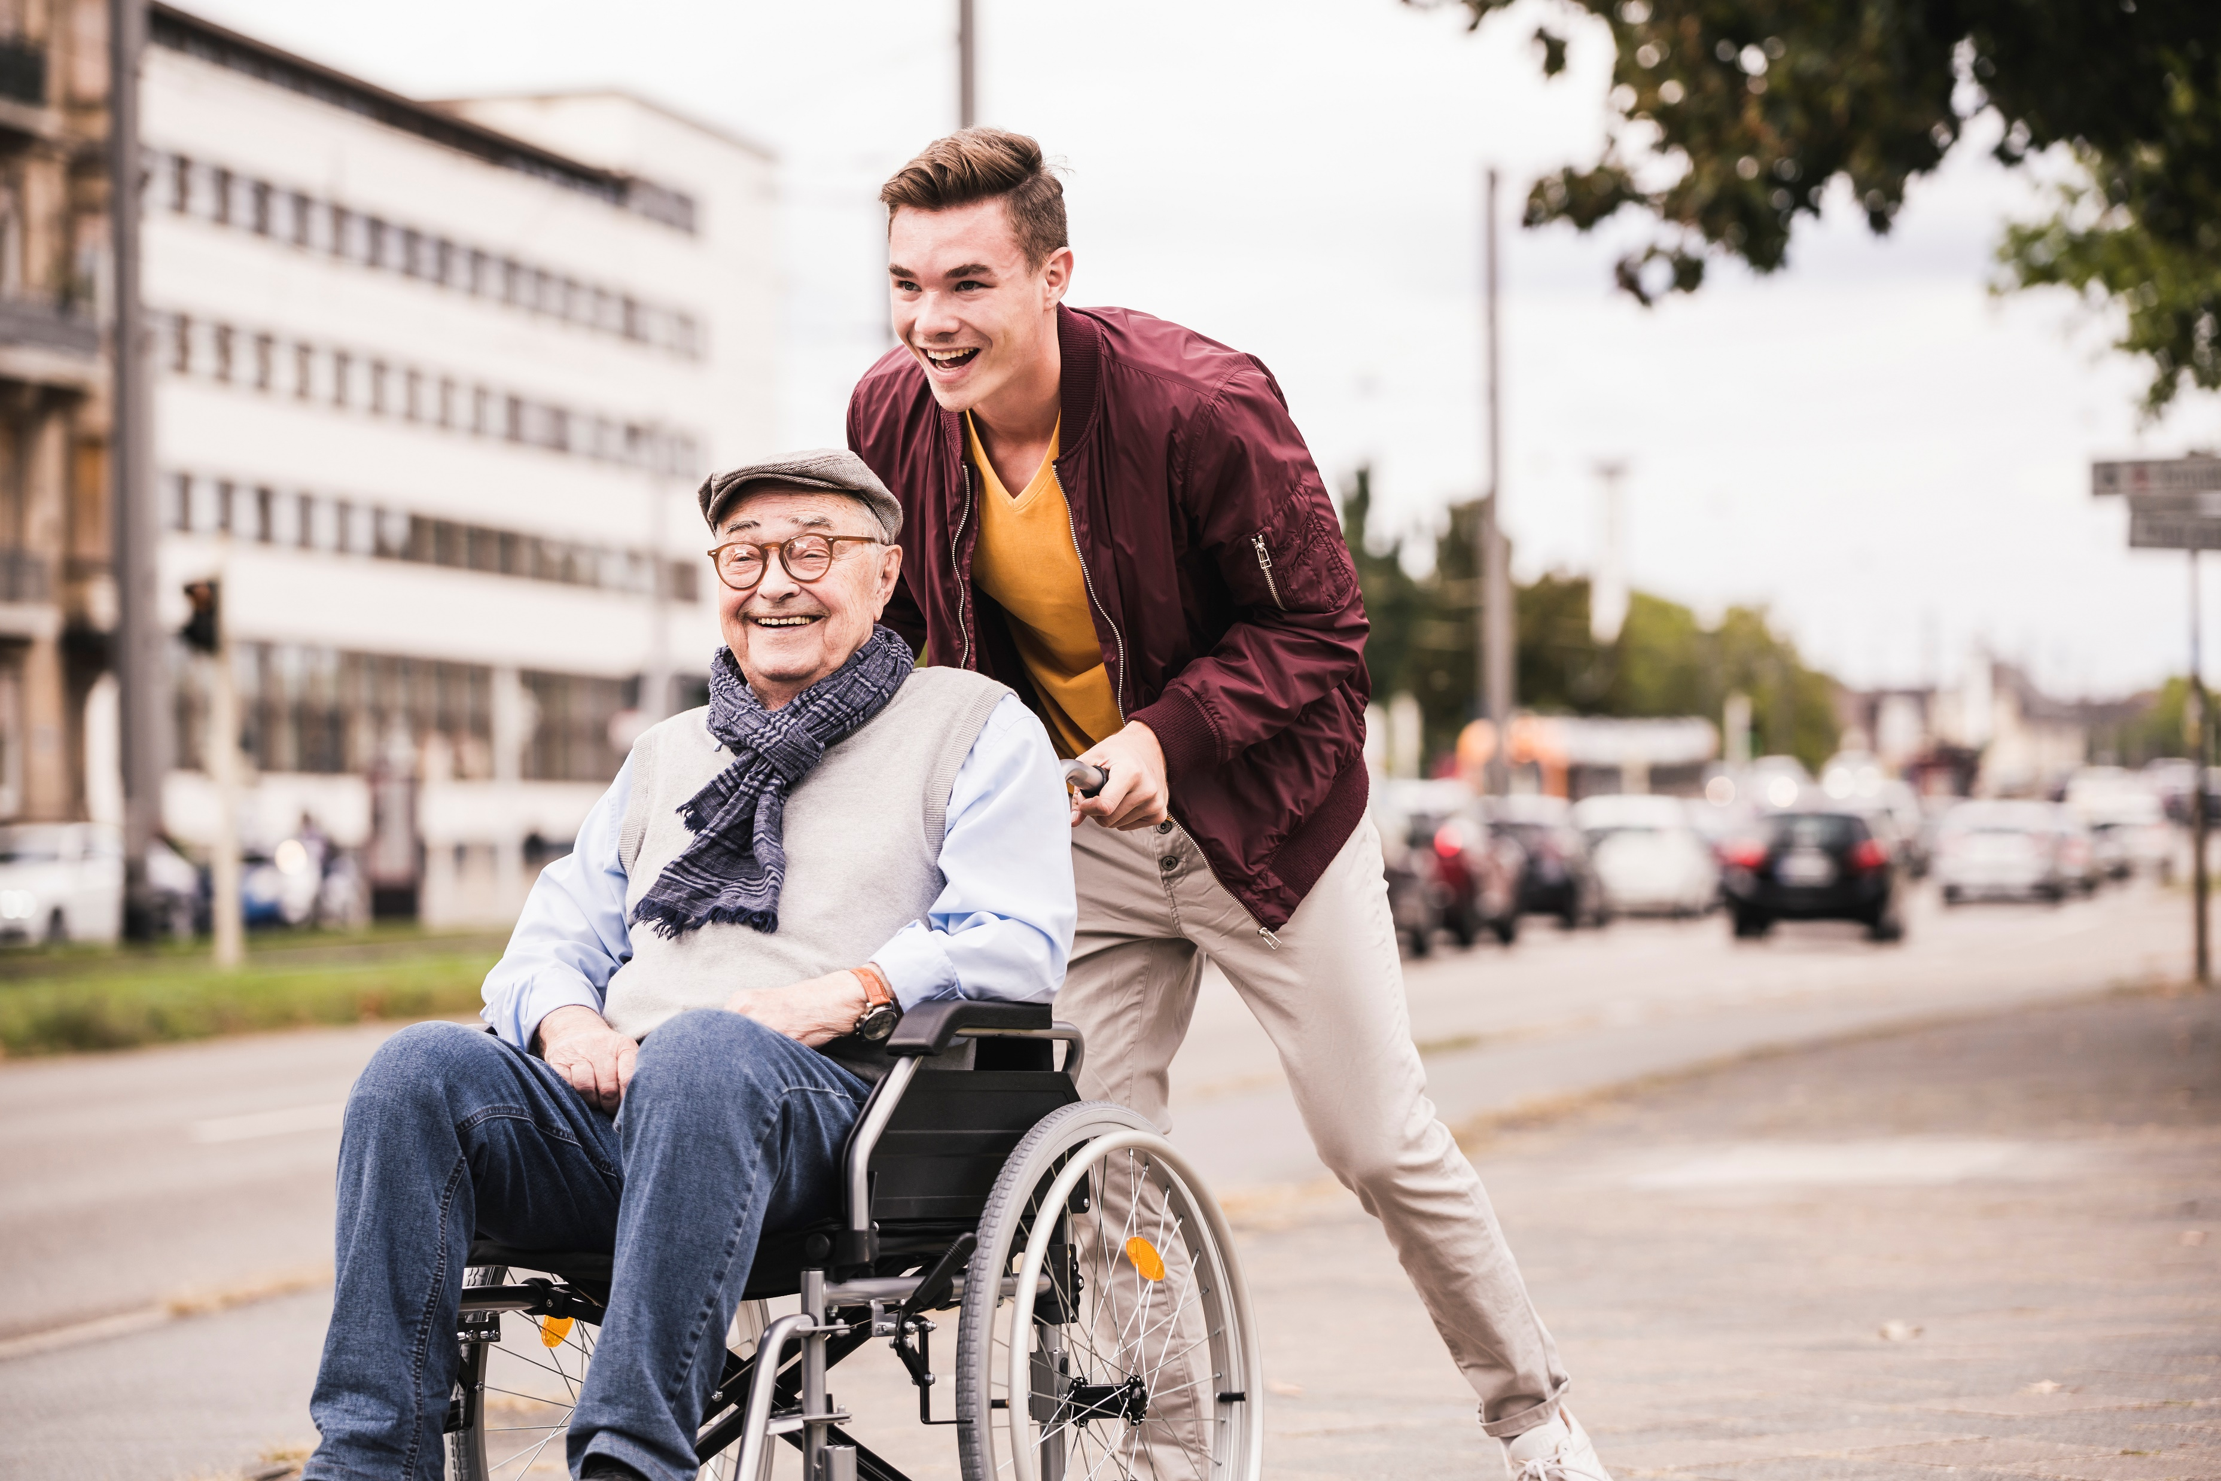
Capital Improvements
2017 (Ad Valorem) Lawton Streets and Roadways
$55 million over 13 years to improve streets and roadways
Rolling Stock (REVRB)
$2.98 million with 50 cent increase in REVRB Fee
2019 PROPEL CIP
Continued Funding for 2014 & 2015 Sales Tax CIP
Development of Capital Management Program (Garver)

Slide 10
Fees
Budget Includes
1.5% CPI Increase on Utility Fees
50 cent increase in REVRB fee

Slide 11
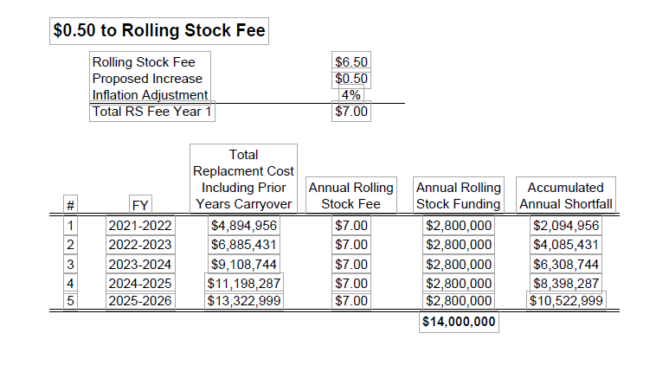
REVRB FEE

