Slide 1
City of Lawton
FY 2023 Budget Presentation - Revenues

Slide 2
Schedule of FY 2023 Budget Meetings
April 25 - Revenues
May 4 – Personnel & Operations/Maintenance
May 6 – Capital Improvement/Capital Outlay
TDB – Summary/ Wrap Up/Adoption

Slide 3
Level of Unrestricted Net Position

Slide 4
General Fund Unassigned Fund Balance

Slide 5
Financial Concerns on July 1, 2022
Negative Unrestricted Net Position
Flat Unassigned Fund Balance
Negative balance in the Health Fund of $2,173,000
An unfunded non-uniformed employee pension plan of roughly $40,000,000 which is growing by $200,000 per year.

Slide 6
City of Lawton – Revenue Mix

Slide 7
Revenue Projections for FY 2023
Revenue Category | FY 2020 Actual Revenues | FY 2021 Actual Revenues | FY 2022 Projected Revenues | FY 2023 Preliminary w/7.5% CPI | % Inc.
Taxes | $ 60,366,356 | $ 67,456,764 | $ 72,377,256 | $ 75,002,980 | 104%
Charges for Services | 42,961,638 | 45,741,829 | 49,543,107 | 52,929,415 | 107%
Fines and Forfeitures | 4,003,647 | 5,361,295 | 2,083,756 | 2,127,894 | 102%
Licenses & Permits | 742,117 | 687,232 | 1,080,033 | 1,148,808 | 106%
Parks and Recreation | 474,727 | 442,581 | 454,564 | 487,440 | 107%
Grants | 3,174,834 | 12,978,561 | 13,035,220 | 3,981,126 | 31%
Animal Welfare | 409,600 | 292,755 | 113,738 | 100,300 | 88%
Interest/Loans | 11,229,101 | 9,128,735 | 15,672,580 | 17,338,485 | 111%
Miscellaneous Revenue | 24,769,516 | 34,808,901 | 31,467,088 | 36,181,926 | 115%
Total Revenues | $ 148,131,537 | $ 176,898,654 | $ 185,827,342 | $ 189,298,374 | 102%

Slide 8
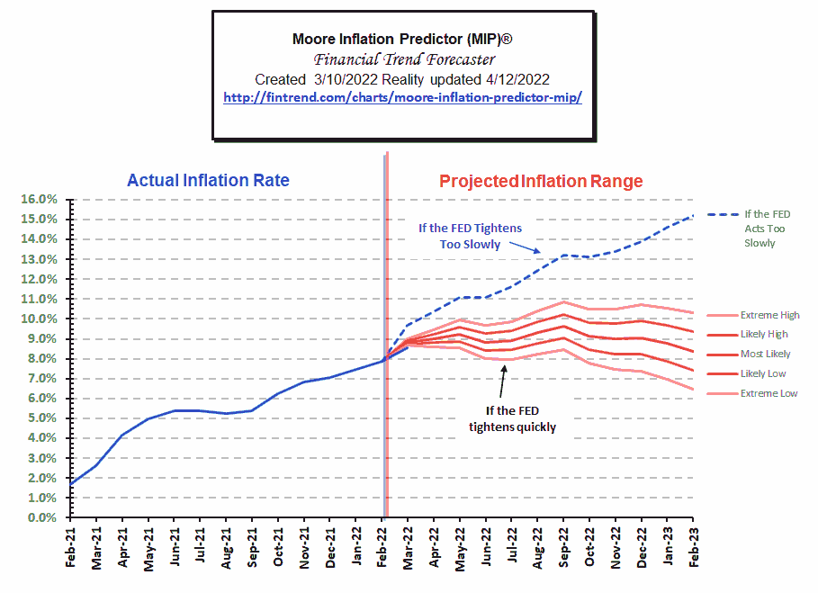
Inflation Prediction

Slide 9
Current Price Increases
Equipment Maintenance Increases
Equipment Cost Increases
Tires – 24%
Oil – 43%
Unleaded Fuel – 53%
Diesel Fuel – 67.5%
DEF per gallon – 123%
Vehicles – 7.5%
Refuse Carts – 46% per load

Slide 10
Current Price Increases (Continued)
Chemical Cost Increases
Material Cost Increases
Aluminum Sulfate – 15%
Sodium Hydroxide – 87.7%
Sulfuric Acid – 94.7%
Liquid Oxygen – 31%
Rock Hauling – 39%
36” Pipe – 111%
10” Pipe – 73%
What does this mean? With an average increase in chemical cost of 57.1%. If it cost the City $100,000 to operate the WWTP in 2021 it is now costing the City $157,100.

Slide 11
FY 2023 Revenue Summary
With a 7.5% CPI increases the City can balance budget but will need to utilize some reserves to do so.
By implementing a 7.5% CPI which was the benchmark in December 2021 the City is already behind the CPI increases as of March 2022.
The CPI could be as high as 15% by February 2023.

Slide 12
How do these increase affect Revenues
Increase All Rates by CPI 0f 7.5% - This increase will only be kicking the can a little farther down the road. When we know the CPI increase is already at 8.54% and will likely be at 10% - 15% before July 2023. This increase will allow the City to balance the budget but with the usage of $9,173,000 from the City’s Fund Reserve.
Increase All Rates by CPI of 10% - This increase will generate an additional $11,345,000. This additional revenue will circumvent the need to drawdown the fund reserve by $9,173,000. At this rate, the City will be able to add to the Fund Balance by $2,172,000.
Increase All Rates by CPI of 15% - This increase will generate an additional $17,017,500. Which will circumvent the need to drawdown the fund reserve and add an additional $7,844,500 which is greatly needed to ensure the City can operate in the case of an emergency.

Slide 13
FY 2023 Revenue Recommendation
The City needs to increase all rates and fees 15% for optimal service delivery.
An increase of 10% would allow the city to provide service delivery for the next budget year.
An increase of 7.5% will make management and staff to continually address issues on a fire-by-fire basis and could have negative repercussions and not allow the City to improve its financial condition.

